Slide 1


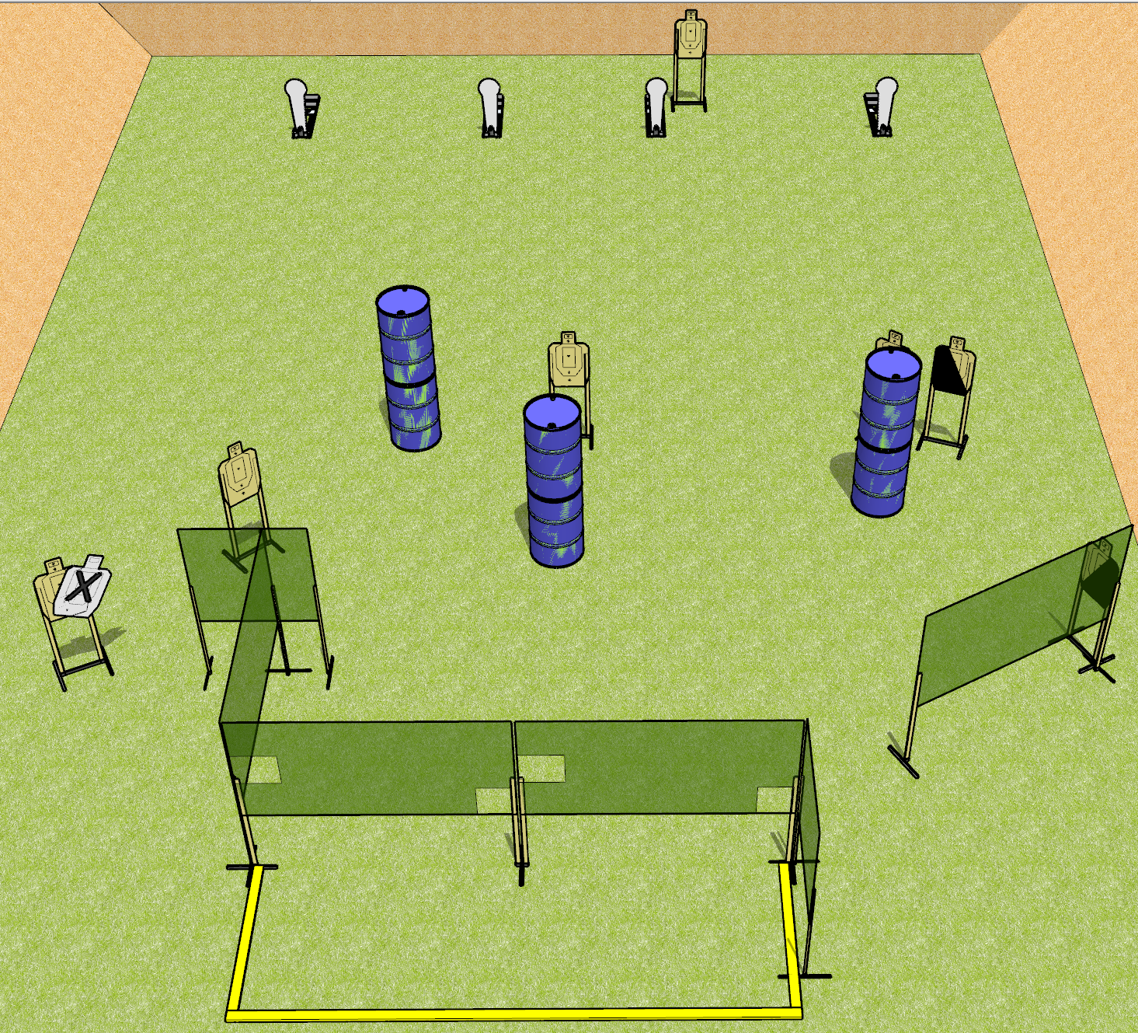
 | Dothan Gun Club – USPSA Match Pecking Order Course Designer : Drew Coleman
Round Count 18 rounds 7 USPSA 4 colt poppers
Equipment List 1 medium fault line 9 wall feet 1 left + 1 right diag 6 targets (5 + 1 NS)

Slide 2
Pecking Order
Written Stage Briefing
Pecking Order is an 18 round, 90 point, Comstock course of fire. There are 7 USPSA targets and 4 colt poppers. The best 2 hits on paper will score.
Handgun start position is completely outside the shooting area, wrists below belt. Handgun is loaded and holstered.
PCC start position is completely outside the shooting area, stock on belt. Loaded carbine is held with both hands, safety on.
On the audible start signal, engage targets as they become available from within the shooting area.

